Slide 1


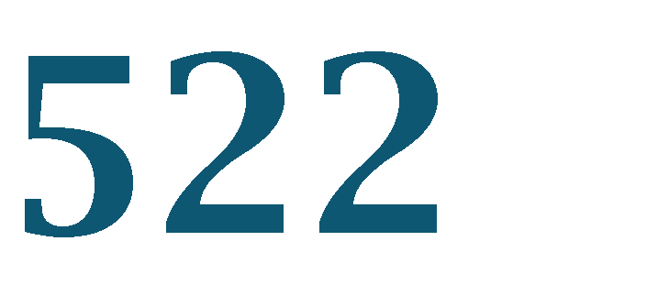





Deep Neural Network

Slide 2





2
Base concepts
Optimizers
Gradient Decent
Batch Normalization
Dropout
Augmentation
Best optimizers(Nestrov, RMS, Adam)
Convolutional NN(CNN)
Basic idea
Pooling Layer
CNN modeling
Batch Size
Epoch
Transfer Learning
Recurrent NN

Slide 3












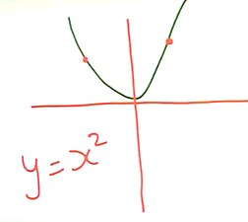
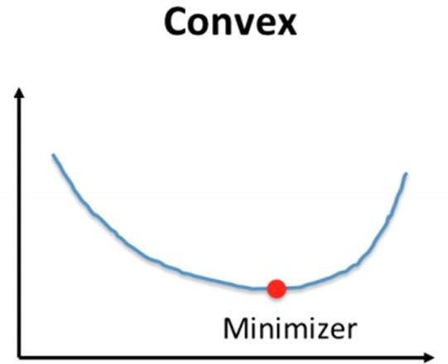






3
■
■
Let’s take an example:
If we draw the graph from expression, 𝒚 = 𝒙^{𝟐}, we will get the graph in OVALبيضاوى shape, then it is called CONVEX Function.
If we take any 2 points on this plane except the minimum point, we got the above function.
For Convex function, we have 1 minimum point called

Slide 4





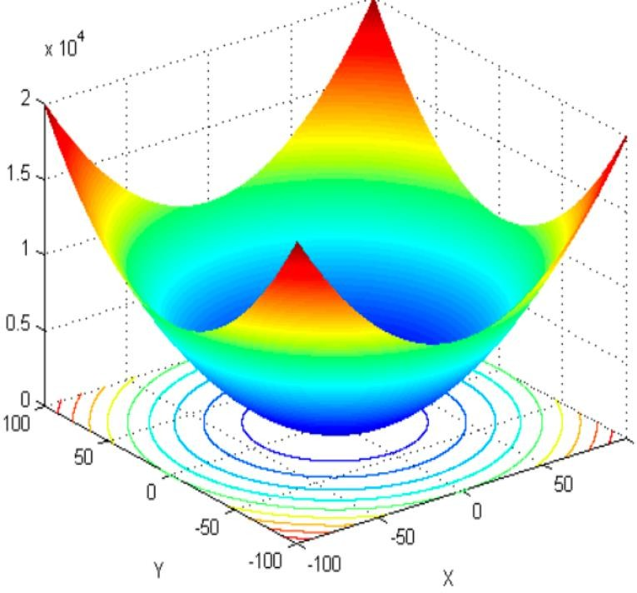




4
■
If we take convex function with and if we take any points with similar heights on this graph, it will sketch one round circle on the surface of convex function.
These circle are called
The counter-line are used to visualize the 3D or 2 variables
convex function in a 2D plan using circle.
It also, allow us to of

Slide 5
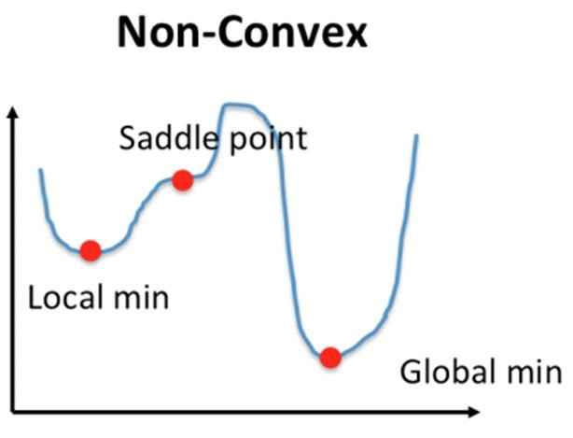



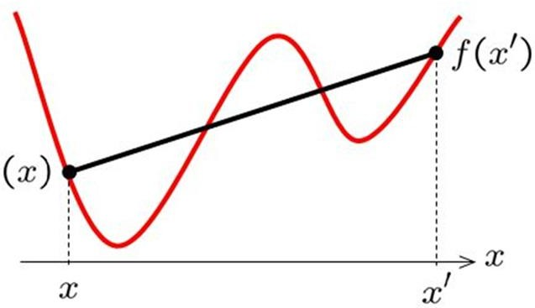
5
■
In the non-convex function, there’s no straight line, nor
it is a smooth curve.
It is curve with multiple ups and down
This kind of functions are called Non-Convex
Function

Slide 6






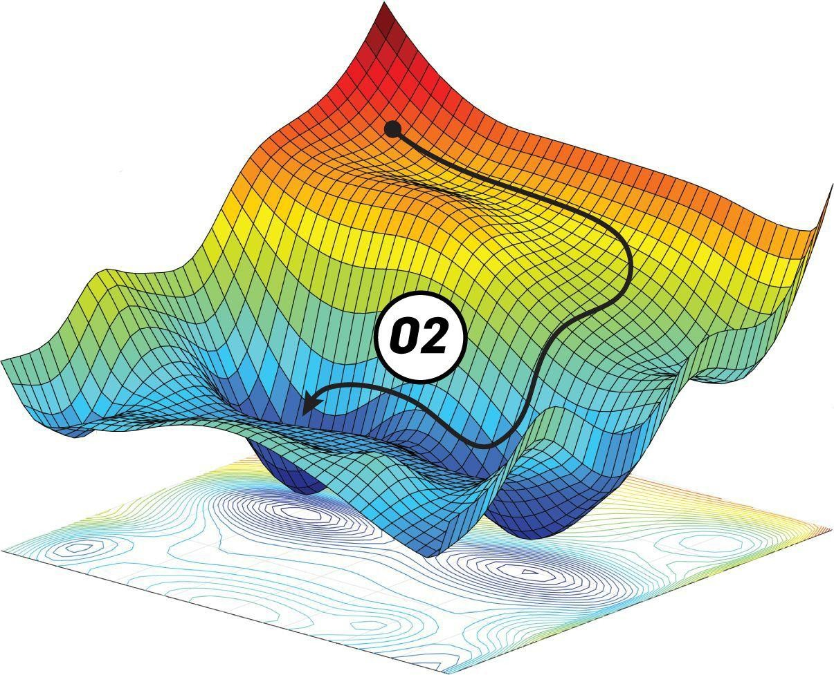
+
6
▪
Contour line give us clear view that where is the minimal local or global minima exist.
Now Let’s map these Functions with Deep Neural Network.

Slide 7


7
DNN models for regression model are using loss functions (mean-square-
error, Absolute-Mean-Absolute error etc.).
If fact, these loss functions are 1-variable convex function and has one minimal point (also called global minima).
With classification, we are using Non-Convex Function approach, because we have more than 1-variables and for that variables, we are finding out the global minimal point that have minimum error value for Loss function.
Let’s take an example, where we will try to find that the neural network is working with a Non-Convex function.

Slide 8
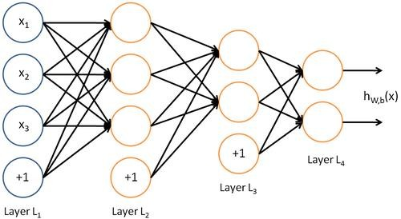
8
1
2
3
4
5
6
7
8
9
2
1
The NN has some inputs, hidden layers and output layer. The weights are initialized with random
values.
The first neuron have W’s = 1, 4, 7, 8 while second neuron has W’s = 2, 5, 8, 2 etc. and third neuron has W’s = 3, 6, 9, 1.
It means there are different local points (weights) for the value that we need to find out.

Slide 9
9
Now, if we exchange (SWAP) the W’s assign to neuron. We will get the
same values.
Means we are getting for different possibilities of the weights
same value
assign to NN, and we are getting almost same global minima.
With multiple W’s, we have multiple local minima’s and one of them is
global minima.
By using technique, we updates the W’s values and
Backpropagation
calculate the LOSS function of the model.
In fact, we are the Global Minima throughout the process.
trying to find

Slide 10
10
■
Questions:
How we can find out the global minima, if more than one minimal point
exists OR How we can make sure that we are finding the correct minimal (global
minima) point?
Answer: By using Backpropagation and SGD, we are trying to calculate and update the W’s value and then trying to find the minimal point (expected to be global minimal point).
But sometimes, it happen that we can get stuck with the saddle point (which is one of the biggest problem with Non-Convex function).

Slide 11
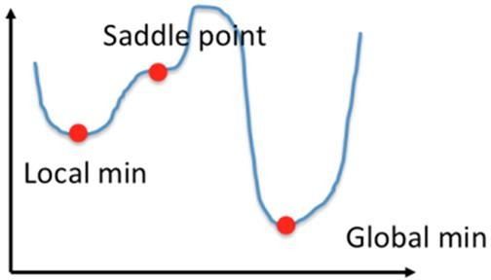

11
Before discussing about the Saddle point, let’s have an example.
In the fig. there’s a small curve having saddle point.
Usually, the saddle points on the function are linear functions, and we know that if we take
derivative of linear function, we are getting constant value.
Means, the saddle point are the points on the function, that are not changing their positions
(they are stuck points) and not allowing us to move either to maximal or minimal point.
Taking differentiations of the saddle points, we are getting answer 0, means that there’s no learning occur and there’s no changes for the model to learn

Slide 12





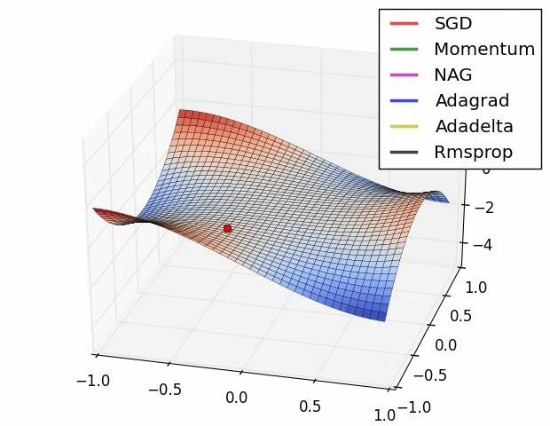
12
As with Backpropagation, we are calculating LOSS and by using SGD updates the W’s and then we are getting good results.
If the model is stuck at some point, we called it SADDLE Point and the model is not getting further tune-up (means not getting new values for W’s), as a result the model is not learning from the data.
This situation is called .
Here we need to add the Learning Rate.

Slide 13

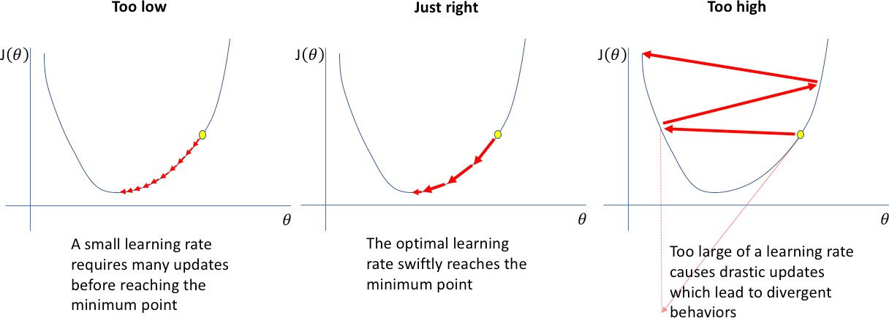
13
the learning rate is a tuning parameter in an optimization algorithm that determines
the step size at each iteration while moving toward a minimum of a loss function.
Learning Rate should be between 0-1.

Slide 14
Learning rate techniques
Predetermined piecewise
constant learning rate For example, set the learning rate to η0 = 0.1 at first, then to η1 = 0.001 after 50 epochs.
Performance scheduling (ReduceLROnPlateau)
Measure the validation error every N steps (just like for early stopping) and reduce the learning rate by a factor of λ when the error stops dropping.
Exponential scheduling
Set the learning rate to a function of the iteration number t:
This works great, but it requires tuning η0 and r. The learning rate will drop by a factor of 10 every r steps.
Power scheduling
Set the learning rate to The hyperparameter c is set to 1. This is similar to exponential scheduling, but the learning rate drops much more slowly.

Slide 15
Batch Normalization, Dropout, Augmentation
+
Documentation
https://keras.io/api/layers/regularization_layers/dropout/
Example
https://machinelearningmastery.com/dropout- regularization-deep-learning-models-keras/
March 28, 2022
25

Slide 16


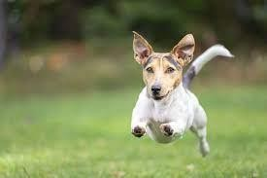

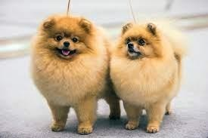
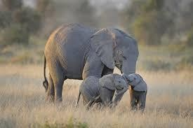

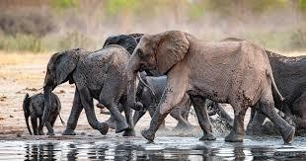




Cat
22
Before discussing Batch-Normalization, let’s take an example,
Non-Cat
Suppose, we are taking images of cat and non-cat to classify by DNN.
Suppose, if we take images for
black-cat
and
classification purpose

Slide 17











23
Before discussing Batch-Normalization, let’s take an example,
Cat
Non-Cat
If we distribute the images data, it will look like this
If we distribute the
images data, it will look like this
Test Dataset
It will be a little bit on the
right side,
because the
images have different colors
representing cat

Slide 18





















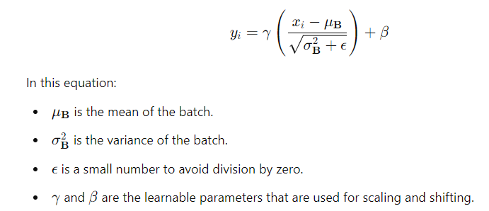
Apply BatchNormalization to each layer to Normalize them,
24
■
■
i.e., adding a with name
BatchNormalization()
sub-layer within hidden layer

Slide 19






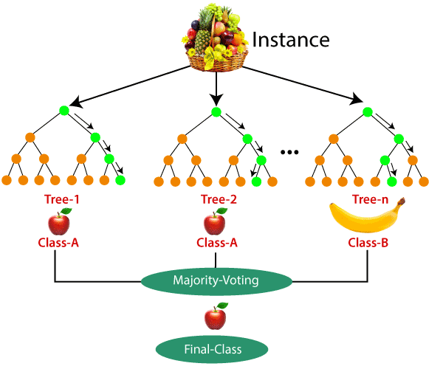
26
Dropout is a technique to avoid overfitting.
But before going to Dropout, let’s discuss about the Ensemble technique and then we
will go Neural Network.
The is using Ensemble technique
Process here is.
Select one-date point as a root and construct
a tree.
Select another data point as a root and
construct another tree
and so on….
Until we construct ‘m’ decision trees

Slide 20

































27
■
Answer: To avoid overfitting
■
Ans: We cannot adopt the Ensemble technique for NN, because, if we want to try with NN, it will take too much time to train the model,
If we want to construct N-number of NN and then train them with different random samples, is almost impossible, because it will take too much time and computation.
Also, during Testing, the data will be provided to all Networks to maintain the Ensemble process

Slide 21
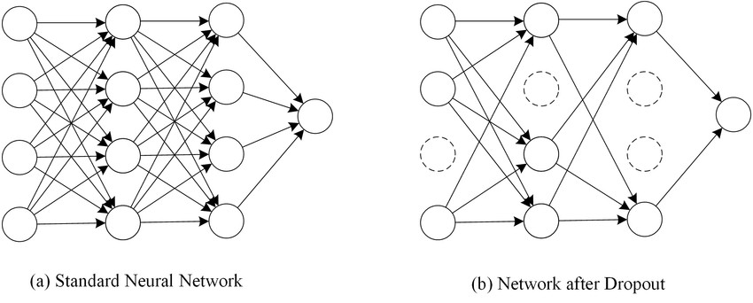
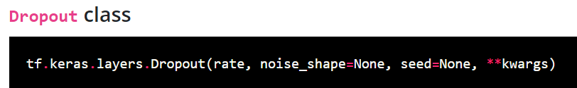
28
Q: What is DROP Out technique?
Answer: This technique is used to implement similar idea like Ensemble technique
but reduce the training/testing computation and time.
In the dropout, we are assigning the probability to each layer including input layer
(here’s say 0.8) and this is not fixed (you may assign any probability value).

Slide 22
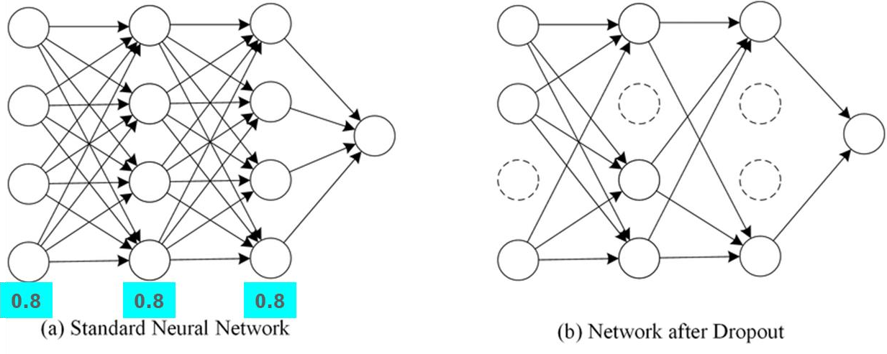
29
Q: What’s this Probability means here?
Answer:
The Probability 0.8 reflects that the any neuron in that layer have 80% chances to keep in
the current iteration while 20% chances are there to avoid any neuron.
This is done for each neuron separately in each layer. The Same process is applicable to
the Input Layers as well to decide about the input participation in each iteration.
For the 2nd iteration, we will have different set of neurons to consider and drop
based on the probability values we are randomly selecting neurons.
The 3rd iteration will have different set of neurons.

Slide 23
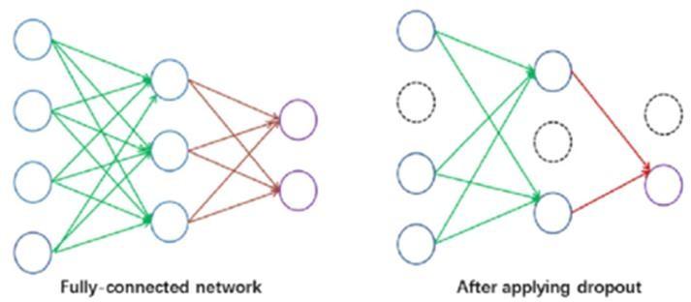
30
Q: What happen with these dropping and
selecting neurons?
Answer: With dropping some of the neurons,
we are forming a in 1st
Thinned network
iteration, while forming different on.
₂nd
in iteration, we are
Thinned network
and so
Q: How many thinned network are possible here?
Answer: In a neural network, if we have N-nodes, then possible
Thinned networks are possible.
₂n

Slide 24

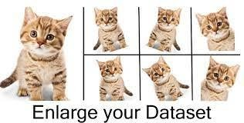
+
51
What is Data Augmentation?
A regularization technique, whereby the dataset is expanded by the creation of artificial variations such as zooming, rotation, shifting, salt/pepper noise, blur etc.
The augmentation approach chosen is often more important than the type of
network architecture used.
Simple data augmentation like rotation, flip, distortion, etc. has proven to improve generalization performance, a simple fact that
adding more variation of the same image makes it
difficult for the model to memorize, i.e., OVERFITTING.
March 28, 2022

Slide 25
Batches, Epochs, Gradient problems, Optimizers.
+
March 28, 2022
52

Slide 26







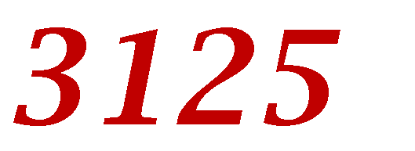
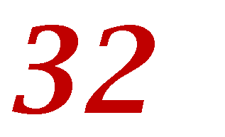
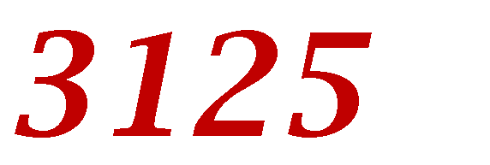

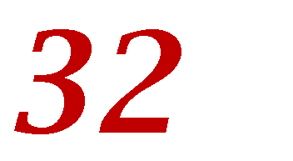


+
53
Loading the data set to the memory we have two options -
You can either load the whole data set to the memory at once
You can load a sample set of data into the memory
While training a neural network, instead of sending the
we in input into of .
,
Number of batches Number of images in a single batch = Total number of data set
Example
Image data set containing
, we can convert it into images in it.
batches where each batch has
Total images = 100000
1 batch = 32 images
So, a total of 3125 batches, (
).
March 28, 2022

Slide 27











+
54
A training dataset can be divided into one or more batches.
Batch Gradient Descent. Batch Size = Size of Training Set
Stochastic Gradient Descent. Batch Size = 1
Mini-Batch Gradient Descent. 1 < Batch Size < Size of Training Set
In the case of mini-batch gradient descent, popular batch sizes include 32, 64, and 128.
■
It simply means that the
.
Alternately, you can
has
than the
from the
or
the
such that the number of samples in the dataset
.
March 28, 2022

Slide 28
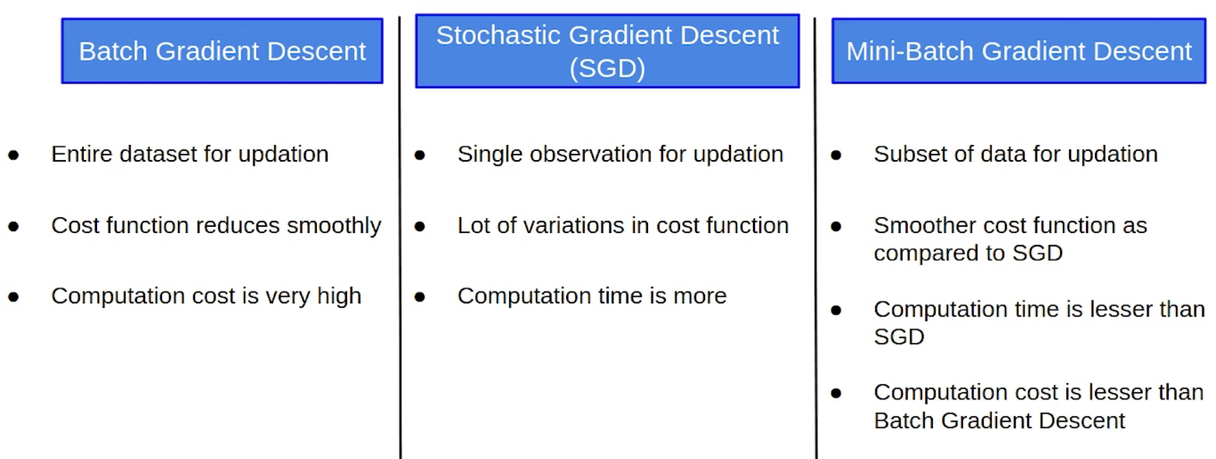

Slide 29
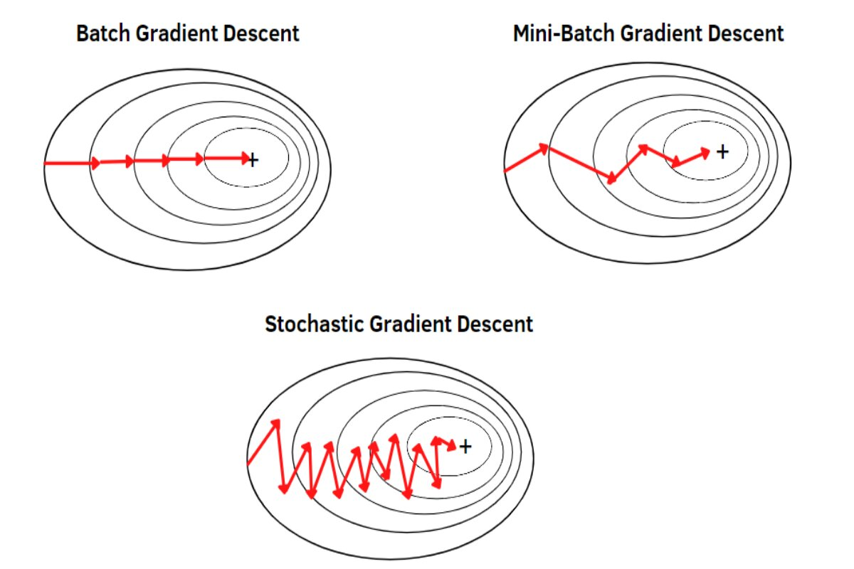

Slide 30










+
One Epoch is when a is passed forward and backward through
55
complete dataset
the neural network only ONCE.
Since one epoch is too big to feed to the computer at once we divide it in several smaller batches.
■
Updating the
One epoch leads to
As the no. of epochs
.
of the curve.
, more
are changed in the
neural network and the curves goes from
The number of epochs is traditionally large, often or , allowing the learning algorithm to run until the error from the model has been sufficiently minimized.
Number of epochs in the literature set to 10, 100, 500, 1000, and larger
March 28, 2022

Slide 31



+
56
Iterations is the number of batches needed to complete one epoch.
The number of batches is equal to number of iterations for one epoch.
Assume the size of the dataset is
batches of . then what will be
1. Batch Size :
2. Number of Batches:
3. Number of Iteration:
and we need divide into
March 28, 2022

Slide 32
+
56
Iterations is the number of batches needed to complete one epoch.
The number of batches is equal to number of iterations for one epoch.
Assume the size of the dataset is
batches of . then what will be
1. Batch Size : 500
2. Number of Batches: 4
3. Number of Iteration: 4
and we need divide into
March 28, 2022

Slide 33
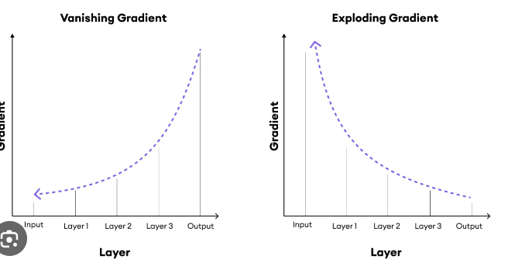
Deep learning Problems
Vanishing gradients problem (or the related exploding gradients problem) lower layers very hard to train.
Second, with such a large network, training would be extremely slow.
Third, a model with millions of parameters would severely risk overfitting the training set.

Slide 34
Gradients problems
Gradients often get smaller as the algorithm progresses down to the lower layers.
The Gradient Descent update leaves the lower layer weights unchanged, and training never converges to a good solution.
This is called the vanishing gradients problem.
The gradients can grow bigger and bigger, so many layers get insanely large weight updates and the algorithm diverges. This is the exploding gradients problem

Slide 35
Solving the first problem(Vanishing)
A paper titled “Understanding the Difficulty of Training Deep Feedforward Neural Networks” by Xavier Glorot and Yoshua.
popular logistic sigmoid activation function.
using a normal distribution with a mean of 0 and a standard deviation of 1.
the hyperbolic tangent function has a mean of 0 and behaves slightly better than the logistic function in DNN.

Slide 36
Faster Optimizers
Five ways to speed up training (and reach a better solution):
Applying a good initialization strategy for the connection weights.
using a good activation function.
Using Batch Normalization.
Reusing parts of a pretrained network.
Using a faster optimizer than the regular Gradient Descent
the most popular ones: Momentum optimization, Nesterov Accelerated Gradient, AdaGrad, RMSProp, and finally Adam optimization.

Slide 38
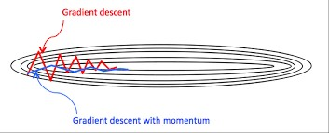


Momentum Optimization Algorithm
Gradient Descent simply updates the weights θ by directly subtracting the gradient of the cost function J(θ) with regards to the weights
(∇θJ(θ)) multiplied by the learning rate η (equation 1)
Momentum optimization cares a great deal about what previous gradients were.
It updates the weights by simply subtracting this momentum vector.
A new hyperparameter β, simply called the momentum, which must be set between 0 and 1, typically 0.9. (equation 2)
Gradient Descent (1)
Momentum Optimization (2)

Slide 39
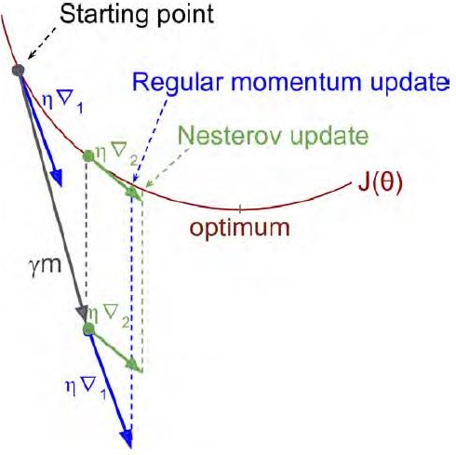

Nesterov Momentum optimization
The only difference from vanilla Momentum optimization is that the gradient is measured at θ + βm rather than at θ.
This small tweak works because in general the momentum vector will be pointing in the right direction
where ∇1 represents the gradient of the cost function measured at the starting point θ, and ∇2 represents the gradient at the point located at θ + βm)

Slide 40
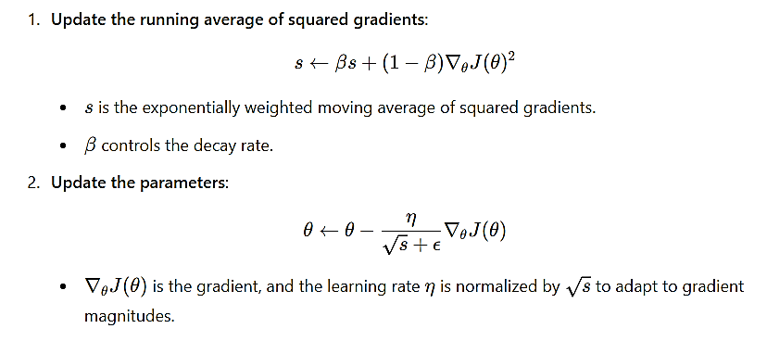
RMSProp
Instead of using just the latest gradient's magnitude to scale the learning rate, RMSProp keeps track of a weighted average of past squared gradients .
The running average helps smooth out the gradient information by looking at recent history rather than just the current gradient, preventing drastic changes in learning rates due to noisy gradients.
Accumulating only the gradients from the most recent iterations (as opposed to all the gradients since the beginning of training).
It does so by using exponential decay in the first step.
generally performs better than Momentum optimization and Nesterov Accelerated Gradients.
In fact, it was the preferred optimization algorithm of many researchers until Adam optimization came around.

Slide 41
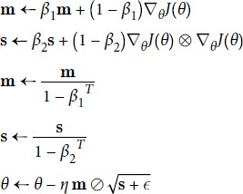
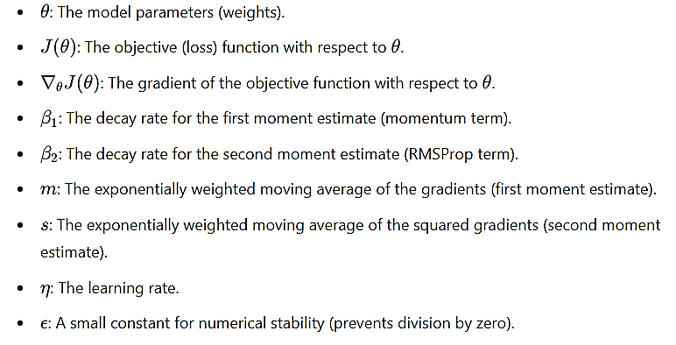
Adam Optimization
Stands for adaptive moment estimation.
Combines the ideas of Momentum optimization and RMSProp.
Steps 3 and 4 are somewhat of a technical detail: since m and s are initialized at 0, they will be biased toward 0 at the beginning of training, so these two steps will help boost m and s at the beginning of training.

Slide 42
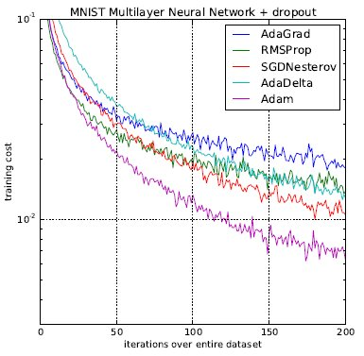
Difference between optimizers

Slide 43
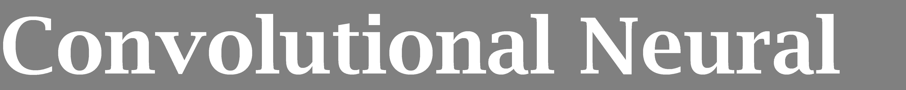
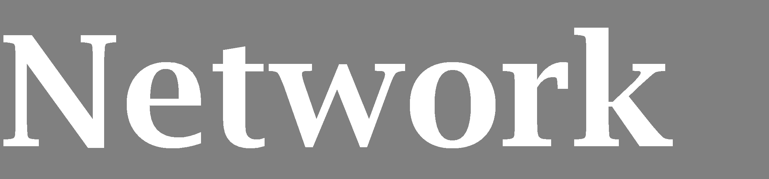
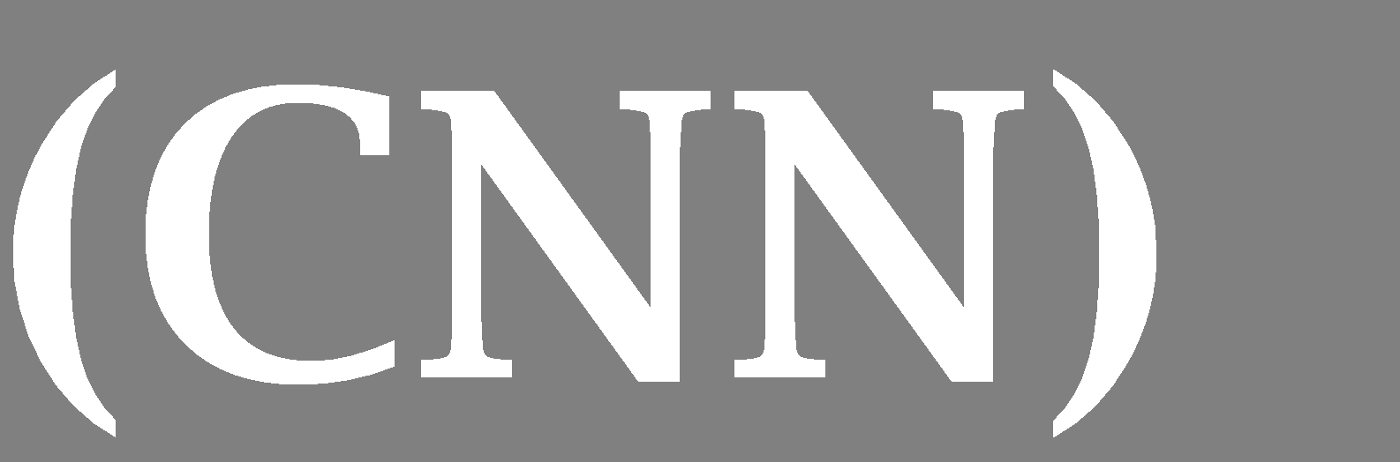
+
Documentation
https://keras.io/api/layers/convolution_layers/convolution2d/
https://towardsdatascience.com/covolutional-neural-network- cb0883dd6529#:~:text=Examples%20of%20CNN%20in%20computer,i.e%2 C%20weights%2C%20biases%20etc.
Example
https://www.tensorflow.org/tutorials/images/cnn
45
March 28, 2022

Slide 44
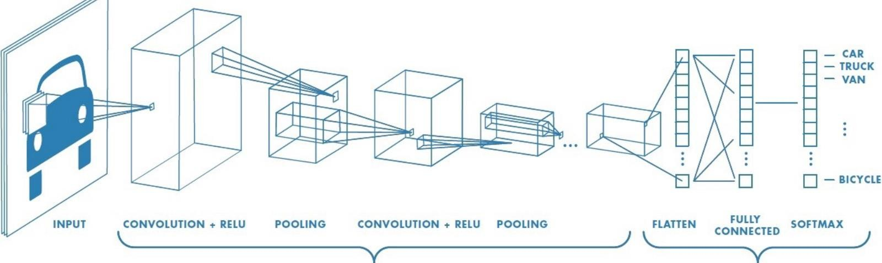
Convolutional Neural Networks
A convolutional neural network (or ConvNet) is a type of feed-forward
artificial neural network.
The architecture of a ConvNet is designed to take advantage of the 2D structure of an input image.
A ConvNet is comprised of one or more convolutional layers (often with a pooling step) and then followed by one or more fully connected layers as in a standard multilayer neural network.

Slide 45
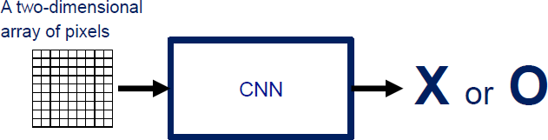
How CNN works
For example, a ConvNet takes the input as an image which
can be classified as ‘X’ or ‘O’

Slide 46
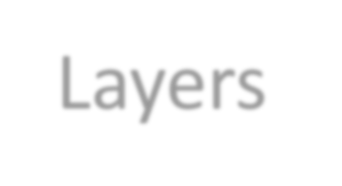

ConvNet Layers
CONV layer will compute the output of neurons that are connected to local regions in the input, each computing a dot product between their weights and a small region they are connected to in the input volume.
RELU layer will apply an elementwise activation function, such as the max(0,x) thresholding at zero. This leaves the size of the volume unchanged.
POOL layer will perform a down sampling operation along the spatial dimensions (width, height).
FC (i.e. fully-connected) layer will compute the class scores, resulting in volume of size [1x1xN], where each of the N numbers correspond to a class score, such as among the N categories.

Slide 47
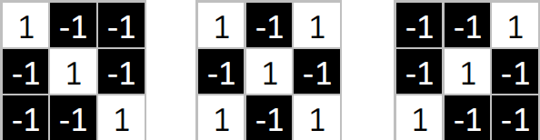
Convolutional Layer - Filters
The CONV layer’s parameters consist of a set of learnable filters.
Every filter is small spatially (along width and height), but extends through the full depth of the input volume.
During the forward pass, we slide (more precisely, convolve) each filter across the width and height of the input volume and compute dot products between the entries of the filter and the input at any position.

Slide 48
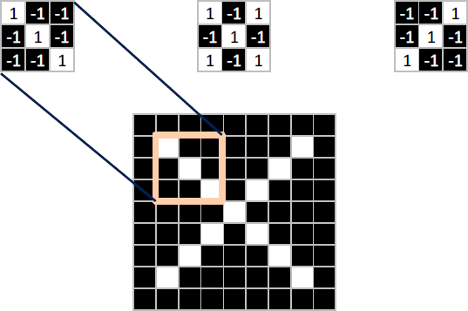
Convolutional Layer - Filters
Sliding the filter over the width and height of the input gives 2-dimensional activation map that responds to that filter at every spatial position.

Slide 49
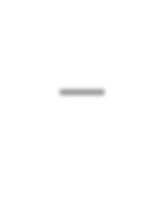

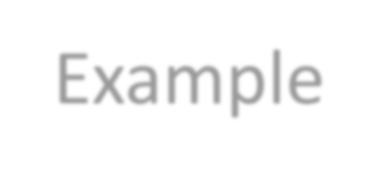

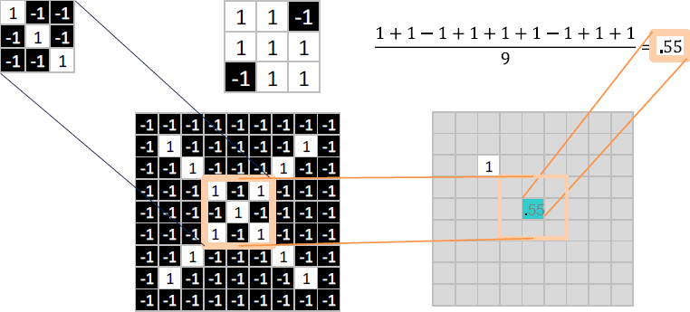
Convolutional Layer – Filters –Example

Slide 50




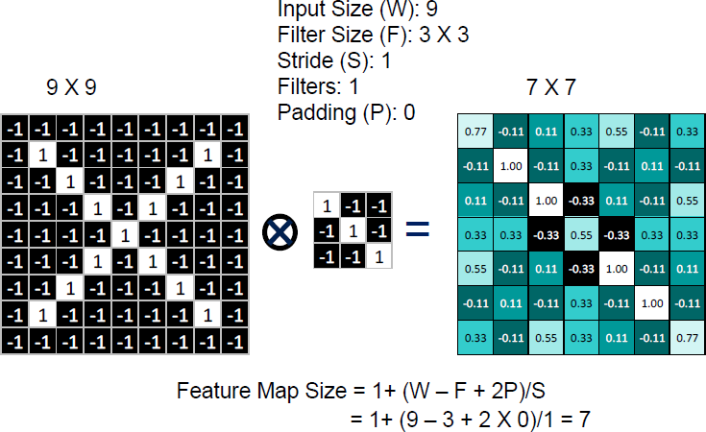
Convolutional Layer – Filters – Computation Example
(valid)

Slide 51




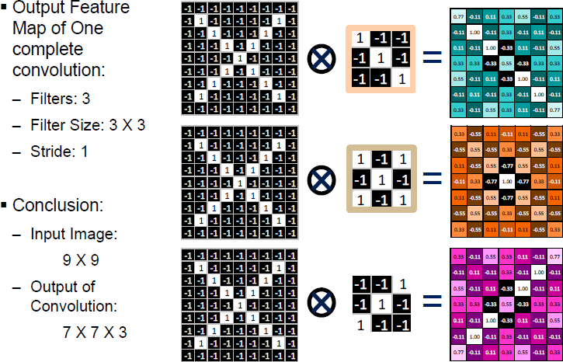
Convolutional Layer – Filters – Output Feature Map

Slide 52
Filters types
Edge Detectors: Identify edges and boundaries.
Texture Detectors: Capture surface patterns.
Color Detectors: Detect specific colors.
Shape Detectors: Recognize shapes and geometric forms.
Gradient Detectors: Capture transitions in color or intensity.
Blob Detectors: Identify homogeneous regions in the image.

Slide 53
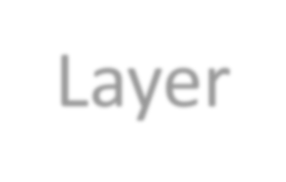

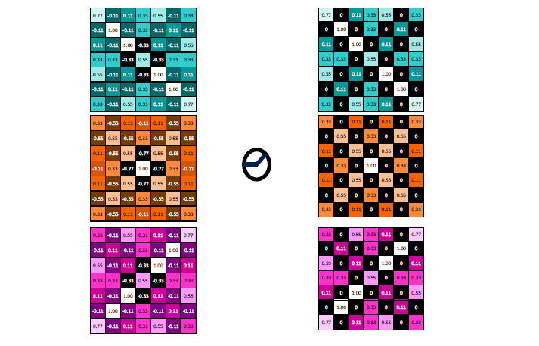
Relu Layer

Slide 54

Pool Layer
The pooling layers down-sample the previous layers feature map.
Its function is to progressively reduce the spatial size of the representation to reduce the amount of parameters and computation in the network
The pooling layer often uses the Max operation to perform the down sampling process.

Slide 55

Pooling Filter example Size = 2 X 2, Stride = 2
Advantages
Dimensionality Reduction: Leads to faster and more efficient processing.
Overfitting Control: Reduces the risk of overfitting by decreasing parameters.
Feature Retention: Keeps the most important features while discarding less relevant details.
Translation Invariance: Increases robustness to small input shifts.
Noise Reduction: Helps to filter out irrelevant activations.
Simplified Processing: Provides a refined input for subsequent layers.

Slide 56









+
Output
The output is thus a 1-dimensional tensor of size (input channels).
43
Use blocks as
an alternative to the Flattening block after the last pooling block of your convolutional neural network.
March 28, 2022

Slide 57

Fully connected layer
Fully connected layers are the normal flat feed-forward neural network layers.
These layers may have a non-linear activation function or a softmax activation in order to predict classes.
To compute our output, we simply rearrange the output matrices as a 1- D array.

Slide 58

SoftMax operation
A special kind of activation layer, usually at the end of FC layer Outputs
Can be viewed as a fancy normalizer (a.k.a. Normalized exponential function)
Produce a discrete probability
distribution vector
Very convenient when combined with cross-entropy loss

Slide 59



why not Feedforward Network
+
49
Densely connected network has only recognized patterns globally it will look where it thinks the eyes should be present. Clearly it does not find them there and therefore would likely determine this image is not a dog. Even though the pattern of the eyes is present, it’s just in a different location.
Let’s say it’s determined that an image is likely to be a dog if an eye is present in the boxed off locations of the image above.
Now let’s flip the image.
March 28, 2022

Slide 60

+
Documentation
https://keras.io/guides/transfer_learning/
https://towardsdatascience.com/a-comprehensive-hands-on-guide-to- transfer-learning-with-real-world-applications-in-deep-learning- 212bf3b2f27a
Example
https://www.tensorflow.org/tutorials/images/transfer_learning https://www.analyticsvidhya.com/blog/2021/11/transfer-learning-with-tensorflow/
March 28, 2022
57

Slide 61




+
58
2. Small dataset:
3. Medium dataset:
1. Train on
Imagenet
more data = retrain more of the network (or all of it)
Freeze these
Freeze these
Train this
Train
this
March 28, 2022

Slide 62

+
59
What Is Transfer Learning?
In transfer learning, the knowledge of an already trained machine
learning model is applied to a different but related problem.
The general idea is to use the knowledge of a model (that learned from a task with a lot of available labeled training data) in a new task that doesn't have much data.
Instead of starting the learning process from scratch, we start with patterns learned from solving a related task.
March 28, 2022

Slide 63










+
60
In neural networks dealing with images, usually try to detect edges in the earlier layers, shapes in the middle layer and
In transfer learning, the early and middle layers are used, and we only retrain the task-specific layers. It helps influence the labeled data of the task it was initially trained on.
The task 1 and task 2 must have the same setting for input.
March 28, 2022

Slide 64

Example
DNN that was trained to classify pictures into 100 different categories.
want to train a DNN to classify specific types of vehicles.
Freezing the Lower Layers weights.
Tweaking, Dropping, or Replacing the Upper Layers.

Slide 65

Understanding AlexNet
Consists of 5 Convolutional Layers and 3 Fully Connected Layers (classify 1000 classes)

Slide 66

+
61
The popular transfer learning models using TensorFlow available on.
March 28, 2022

Slide 67

+
Documentation
https://keras.io/api/layers/recurrent_layers/
Example
https://www.tensorflow.org/guide/keras/rnn
https://www.simplilearn.com/tutorials/deep-learning-tutorial/rnn
March 28, 2022
62

Slide 68
+
63
A Recurrent Neural Network (RNN) is derived from feedforward networks and give a temporal dynamic behavior (i.e., deal with sequential data).
It works similarly to human brains to deliver predictive results.
RNN looks quite similar to a traditional NN, except that a memory-state is added to the neurons.
March 28, 2022

Slide 69

+
64
Let’s give word "neuron" as an input to FF-NN and it processes the word character by character.
When it reach to "r," it has already forgotten about "n," "e" and "u," which makes it
impossible for this type of NN to predict which character would come next.
March 28, 2022

Slide 70
+
65
RNN is able to remember those characters because of its internal memory.
It produces output, copies that output and loops it back into the network.
Simply: RNN add the immediate past to the present.
Therefore, a RNN has two inputs: the present and the recent past.
This is important because the sequence of data contains crucial information about what is coming next, which is why a RNN can do while other algorithms can’t.
March 28, 2022

Slide 71


Basic Recurrent Neural Networks (RNN)

Slide 72

RNN has two major disadvantages

Slide 73
RNNs characteristics
Model hidden states (input) dependencies
Errors “back propagation over time”
Feature learning methods
Vanishing gradient problem:
cannot model long-distant dependencies of the hidden states.

Slide 74

Simple RNN vs LSTM
LSTM is even more slower to train as compared to RNN
Vanishing gradient problem still persists
Sequential computation inhibits parallelization
Distance between positions is linear

Slide 75

Long Short-Term Memory (LSTM)
Use gates to control the information to be added from the
input, forgot from the previous memories, and outputted.
σ (sigmoid) used for gates probabilities.
Tanh functions used respectively, to map the value to [-1, 1], where they solve the problem of basic RNN.

Slide 76

Forget Gate
In the first part, we see the sigma mark σ, which represents the gates that control the flow of data, and they control the amount of data that comes in from the old memory that comes from the former output, and if it's 0, 1, or 0.5, it controls this amount of data.

Slide 77

Update Gate
The next cell controls the amount of data that will be added to the next one, and it has values of 0 is 1 or 0.5 that indicate the amount of addition.

Slide 78

In cell number three, it's the one who's taking the data into it and making the new memory.

Slide 79



And then we design the new memory of the cell with this equation.
The image explains the LSTM memory update process:
Forget the old memory we don't need, and add what we need from the new memory.
- Equation:

Slide 80

This next step is controlling the amount of output from the cell.
Output Gate

Slide 81

Then process and produce the output itself with the tanh equation

Slide 82

Long Short-Term Memory (LSTM)

Slide 83

+
66
March 28, 2022

Slide 84




+
67
There are 3 types of recurrent neural network:
The simple (RNN)
Long Short Term
Memory Unit (LSTM).
Gated Recurrent Unit (GRU)
March 28, 2022

Slide 85
+
LSTM Components
67
Forget Gate f(t): Decides how much of the previous cell state
(c(t-1)) to forget, using a sigmoid function.
2. Input Gate i(t): Controls how much new information to add to the cell state, based on the current input.
3. Cell State Update g(t): Generates candidate values g(t) with a tanh function to be added to the cell state. Candidate values are the potential new information generated by the `tanh` function, which could update the cell state. Their impact depends on the input gate controlling how much is added to the memory.
4. Output Gate o(t): Determines how much of the updated cell state to output as the hidden state h(t).
5. Cell State c(t):The memory of the LSTM, updated by the forget and input gates.
6. Hidden State h(t): The output of the LSTM cell at the current time step, determined by the output gate and cell state.
7. Point-wise Multiplication (⊗): Used for element-wise operations like updating the cell state.
8. Addition (⊕): Combines the effects of forget and input gates to update the cell state.
March 28, 2022

Slide 86
+
Here's a brief comparison of LSTM and GRU:
67
1. Gates:
- LSTM has three gates (forget, input, output).
- GRU has two gates (update, reset).
2. Cell State:
- LSTM has a separate cell state.
- GRU combines the cell state with the hidden state.
3. Complexity:
- LSTM is more complex but offers finer control.
- GRU is simpler and faster.
4. Memory Retention:
- LSTM is better for long-term dependencies.
- GRU performs similarly but may not be as effective for very long sequences.
5. Performance:
- LSTM is more powerful but slower.
- GRU is more efficient and faster to train.
March 28, 2022

Slide 87
+
68
End of Lecture
March 28, 2022

